Slide 1
DATA 601 –Ethics Data Visualization
Felix Gonzalez, P.E. (fgonzale@umbc.edu)
Adjunct Instructor
Division of Professional Studies
Computer Science and Electrical Engineering
University of Maryland Baltimore County

Slide 2
Ethical Principles of Data Visualization
Well-designed charts are empowering.
They can also deceive viewers regardless of whether they are designed with ill-intent or not.
Data visualization has ethical consequences
Ethical thinking is not only about intentions, but also about consequences.
Need to explicitly consider ethical principles when creating and distributing visualizations.
Transparency
Integrity
Accountability

Slide 3
Before You Create a Chart
Ask
Who is my audience?
What questions do they have?
What answers am I finding for them?
What am I trying to say?
What other questions will my visualization inspire or what conversations may result?

Slide 4
Data Visualization Best Practices
Identify your target audience
Make sure your data is clean
Select the right chart
Label your chart effectively
Emphasize the important points
Format your chart for accessibility
Make use of color
Ensure your data is readable in any format
Ask for feedback

Slide 5
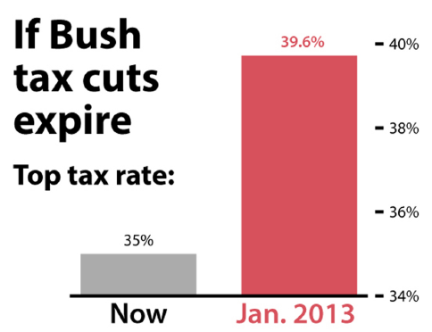
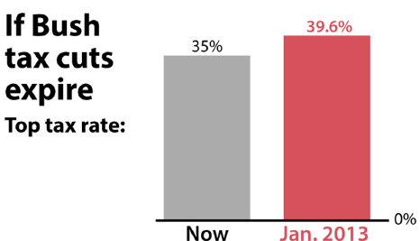
Don’t
It should have been
Notes:
Fox News, 2012

Slide 6
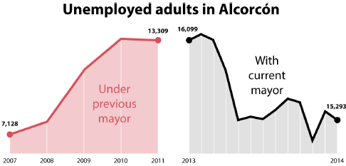
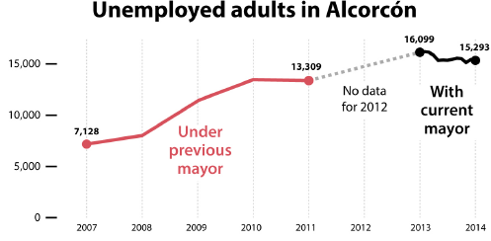
Don’t
Created by the Spanish city of Alcorcon in 2014 to celebrate the success of the current Mayor in increasing employment.
Distorted both vertical and horizontal scales.

Slide 7

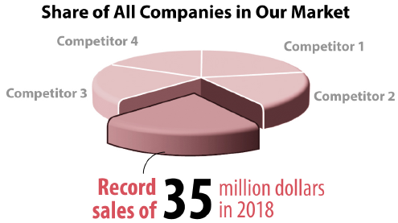
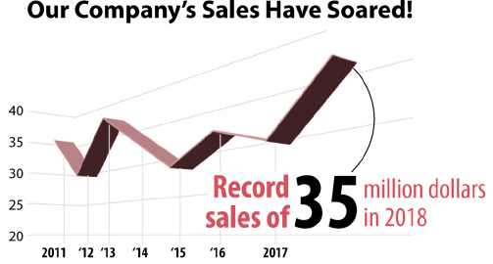
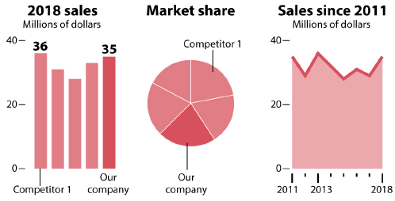
Don’t

Slide 8



Was Kobe a ball hog?
In the 2009-2010 season, Kobe made 9.8 shots per game and had 5.0 assists per game, on average.
10
10
5
5
Made Shots
Assists
Made Shots
Assists
Notes:
This pictograph is misleading. While the number of ‘made shots’ is only double the ‘assists’ per game, the two-dimensional ball figure makes the made shots appear several times as big.

Slide 9
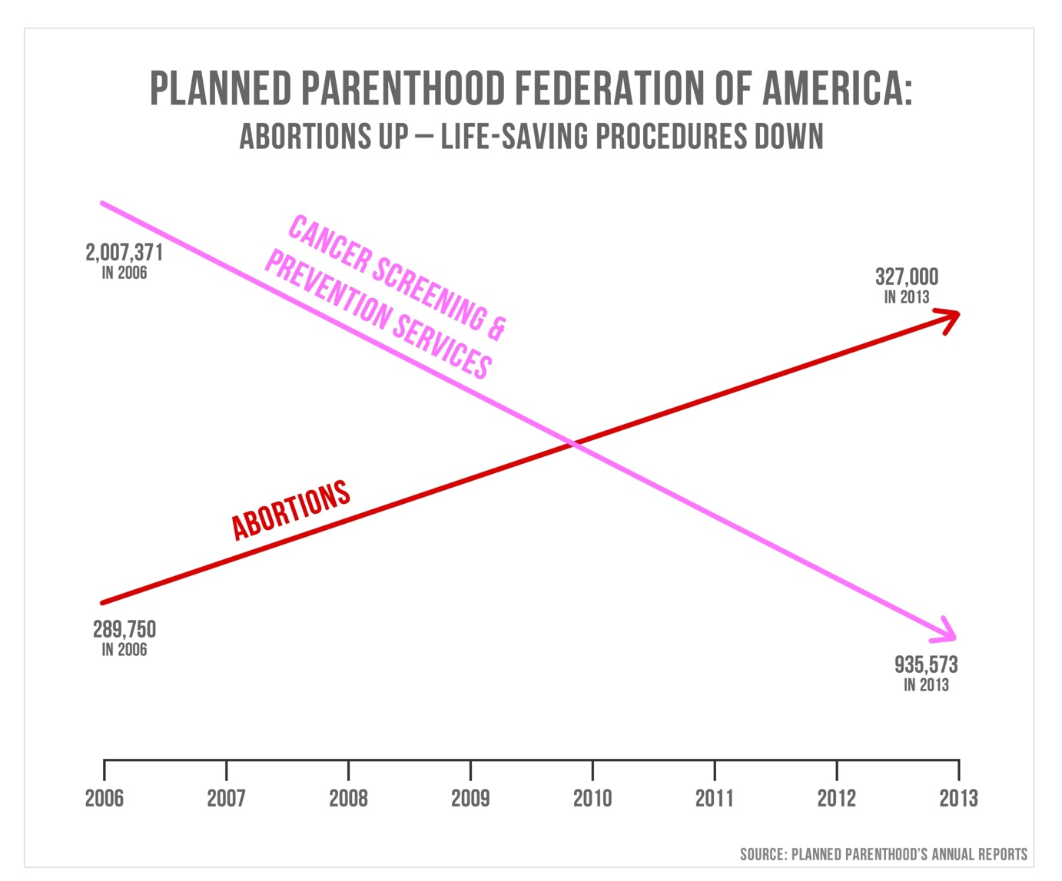
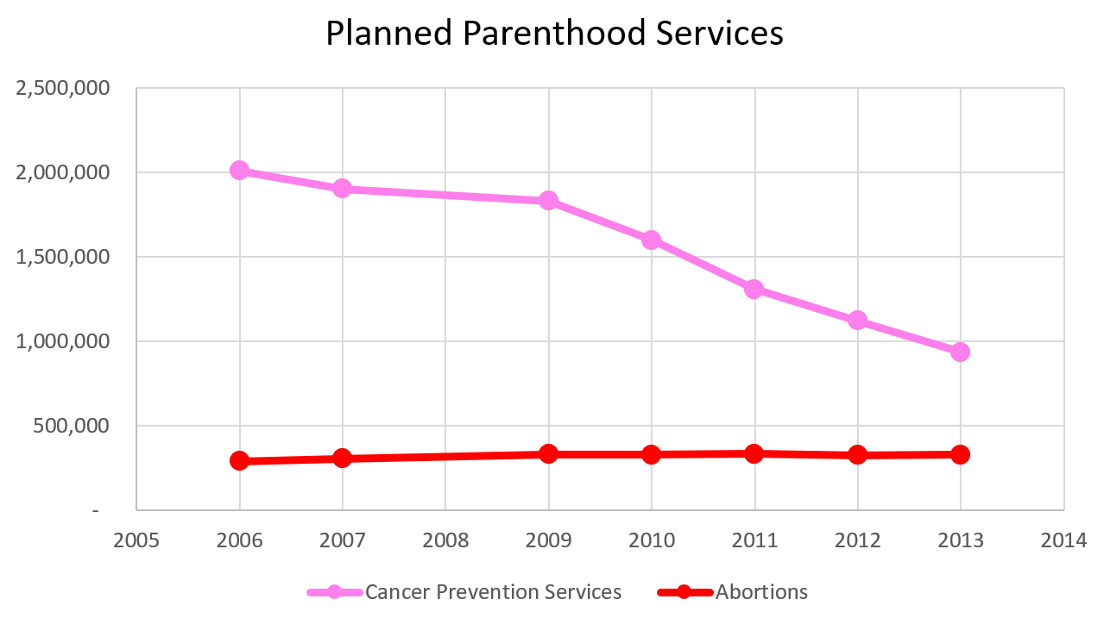

Slide 10
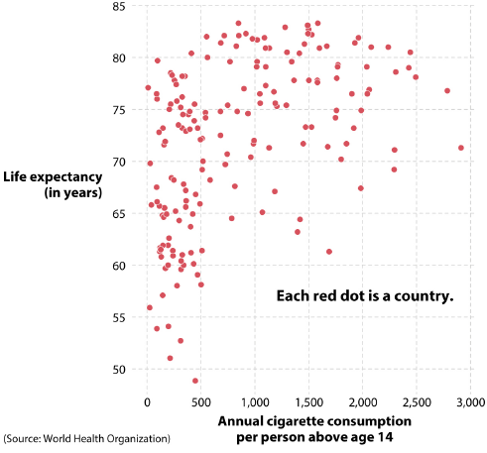
Correlation is not equal to causation
The more cigarettes we consume, the longer we live!!!

Slide 11
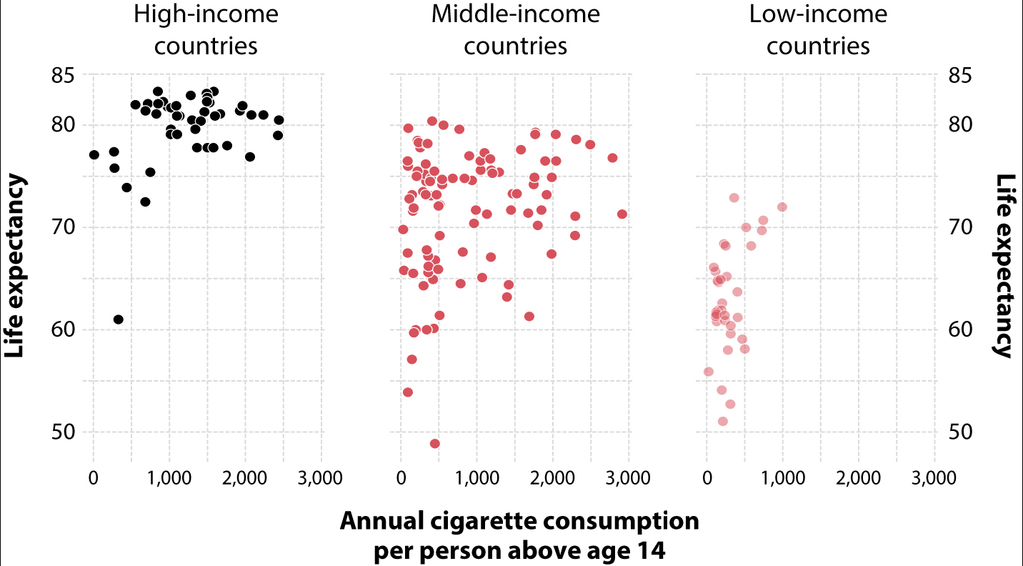
Correlation is not equal to causation

Slide 12
Which Land Mass Is Bigger?
Greenland or the United States?
A. US by 5 times
B. Greenland by 5 times
C. US by 2 times
D. Greenland by 2 times
E. About the same
F. Depends

Slide 13
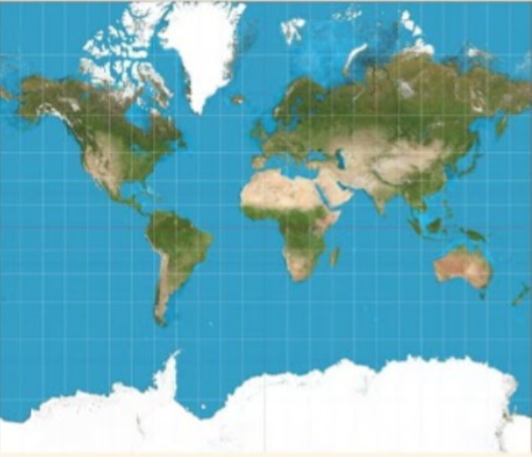
Mercator Projection
Practical Geography Skills: Map Projections: The meaning and examples

Slide 14
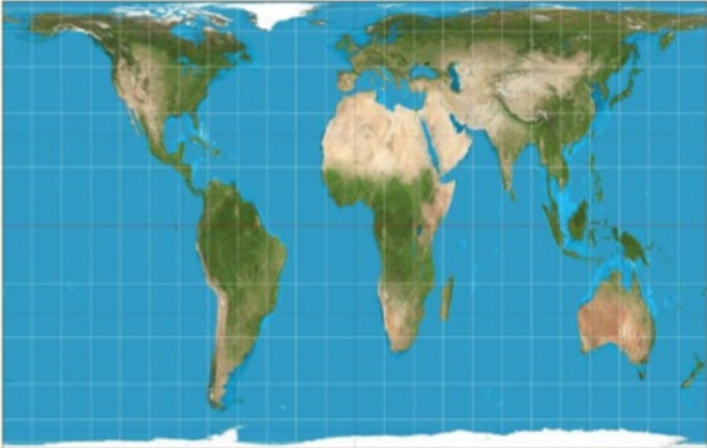
Gall-Peters Projection
Practical Geography Skills: Map Projections: The meaning and examples

Slide 15
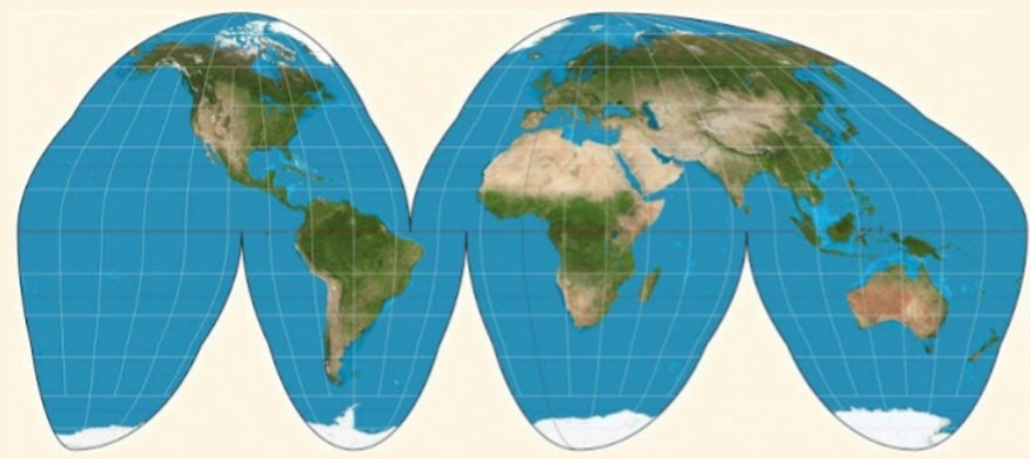
Goode-Homolosine Projection
Practical Geography Skills: Map Projections: The meaning and examples

Slide 16
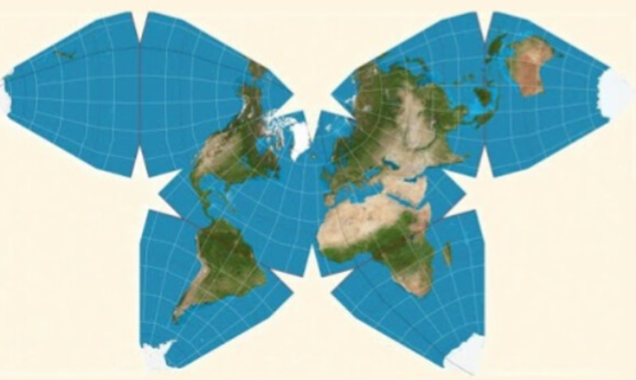
Waterman Butterfly Projection
Practical Geography Skills: Map Projections: The meaning and examples

Slide 17
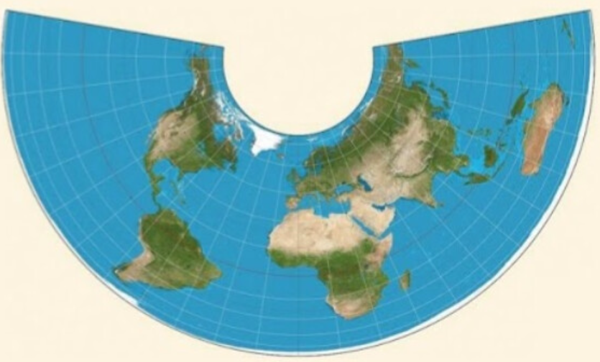
Albers Projection
Practical Geography Skills: Map Projections: The meaning and examples

Slide 18
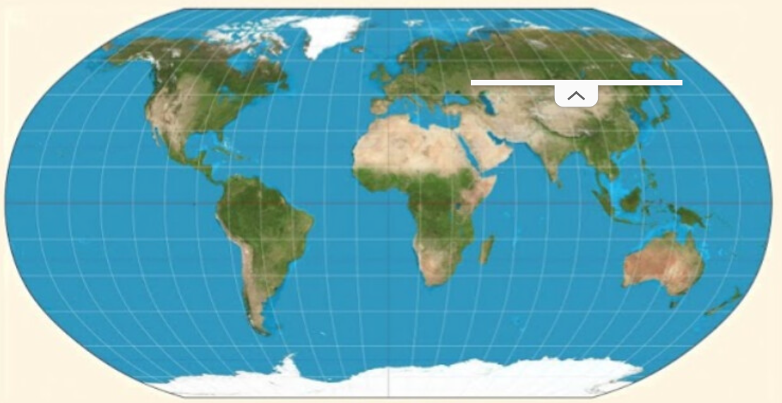
Robinson Projection
Practical Geography Skills: Map Projections: The meaning and examples

Slide 19
Map Projections Land Mass Comparison
Which land mass is larger? Greenland or the United States?
A. US by 4.5 times
B. Greenland by 4.5 times
C. US by 2.3 times
D. Greenland by 2.3 times
E. About the same
F. Depends
Which Map Projection is it more appropriate and why?
Notes:
For the General Public?
For Geographers?
Other stakeholders?

Slide 20
Questions?

